Slide 1




Dockers & K8s
By
Ashok Kumar

Slide 2

Introduction to Virtualization Technologies
Full DevOps/ Auto DevOps
Docker 101
Docker 201
Basic of K8s
K8s 101

Slide 3
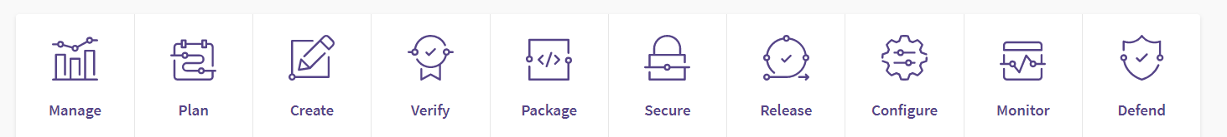
Full DevOps/Auto DevOps

Slide 4
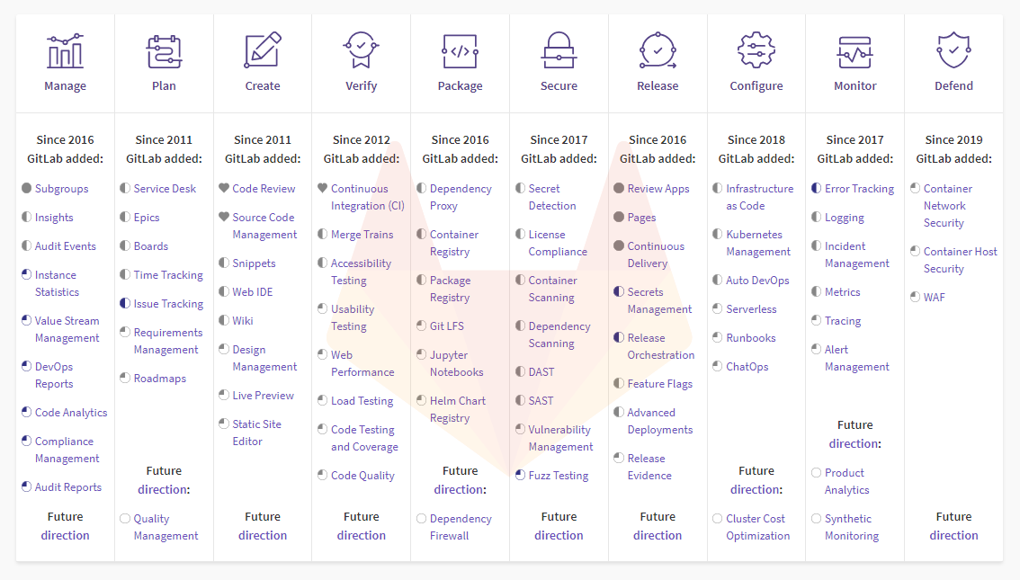
Full DevOps/Auto DevOps

Slide 5
Introduction to Virtualization Technologies
There are three techniques which we are using while we are deploying our products
Pre virtualization World Hypervisor-based virtualization Container-based virtualization

Slide 6
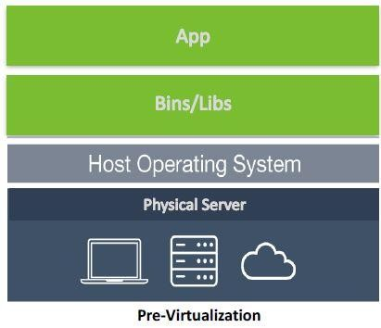
Pre virtualization World
The problems are
Huge Cost
Slow Deployment
Hard to migrate

Slide 7
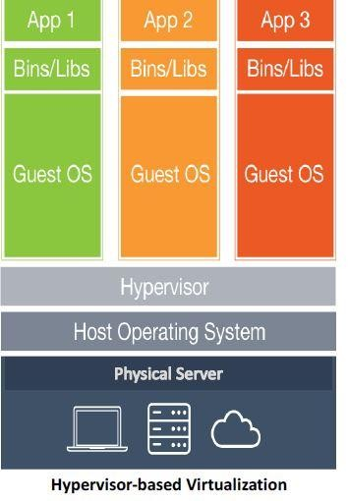
Hypervisor-based virtualization
Benefits:
Cost-Efficient
Easy to Scale
Limitations:
Kernel Resource Duplication
Application Portability Issue

Slide 8
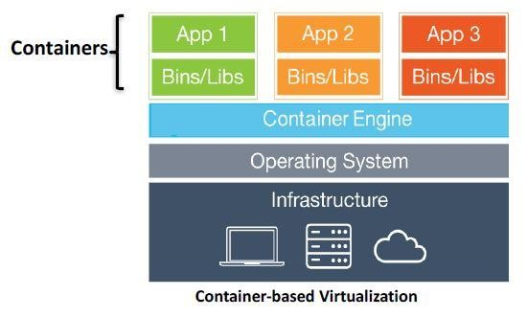
Container based virtualization
Containers virtualize at the OS level.
Benefits:
Very Light weight
Boots up in seconds
Take fraction of disk and memory
Cost-Efficient
Fast Deployment
Guaranteed Portability

Slide 9
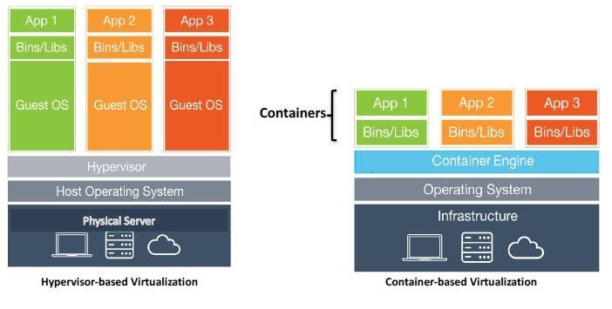
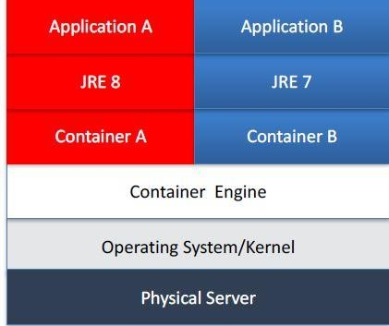
Hypervisor-based VS Container-based Virtualization
•
Runtime Isolation

Slide 10
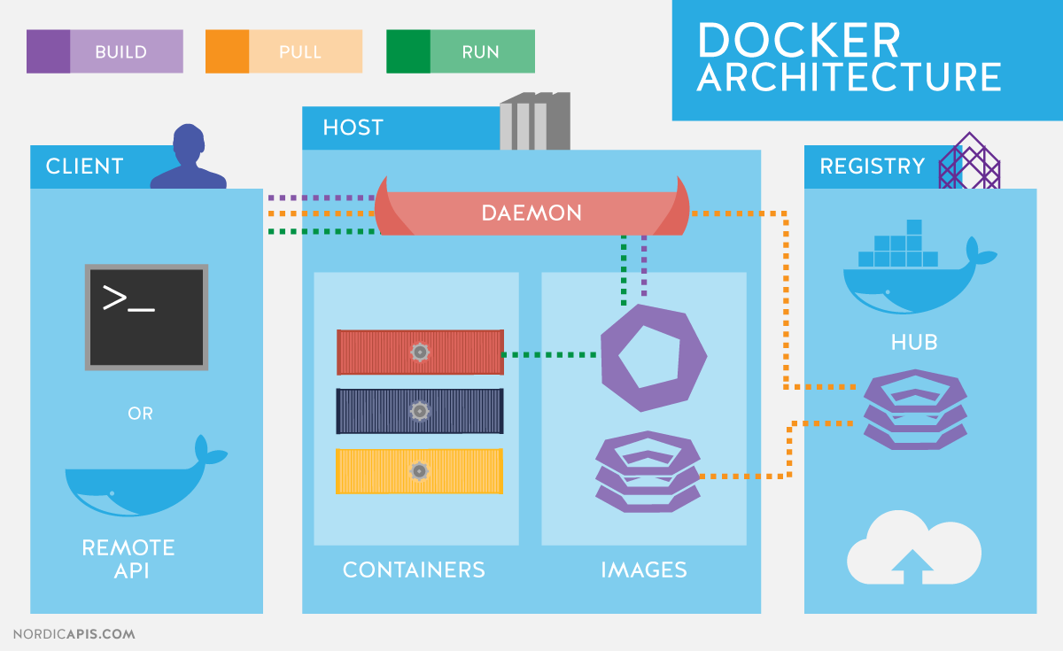
pc:

Slide 11
Continue..
Portability Isolation
Resource efficiency
Scale
Speed

Slide 12
Continue..
It is one implementation of container based virtualization technologies.
Important components of the docker are
Images
Containers
Registries and Repositories

Slide 13
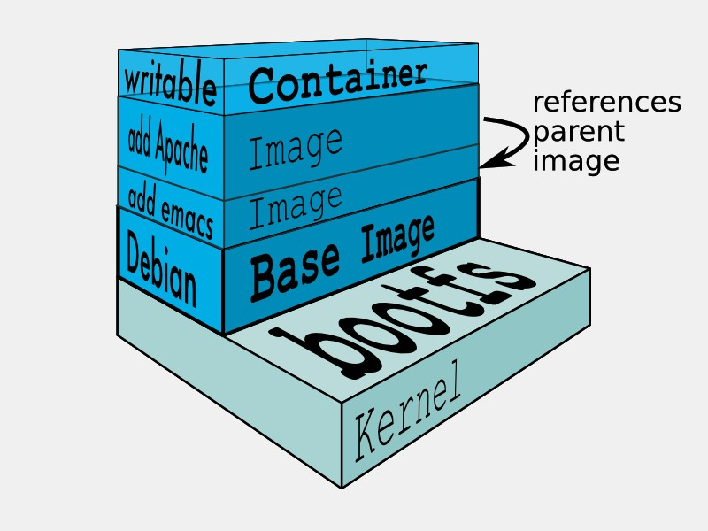
Images
Images are read only templates used to create containers, created with the docker build command, either by us or by other docker users.
Images are composed of layers of other images , stored in a docker registry.

Slide 14
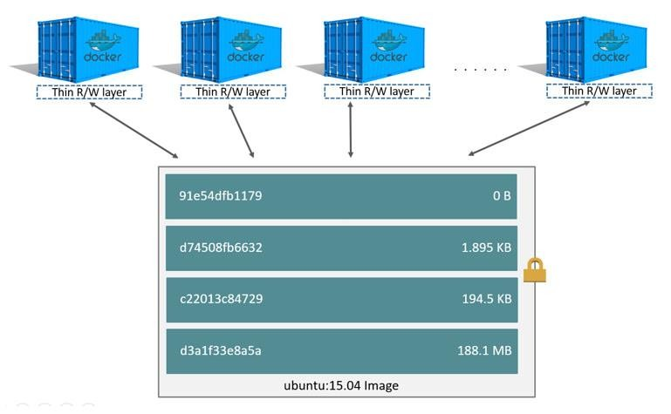
Continue..
Image layers

Slide 15
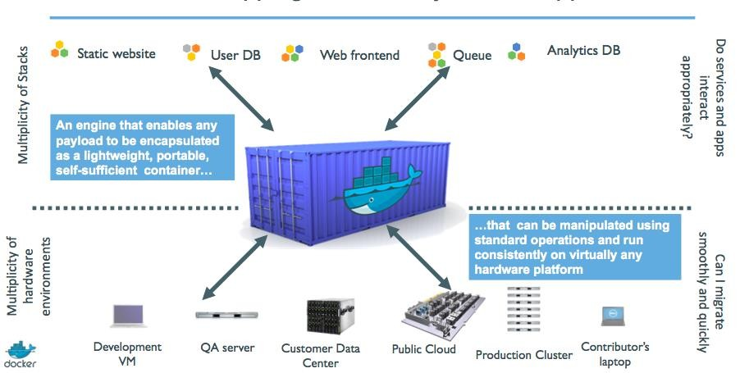
Containers
If an image is a class, then a container is an instance of a class - a runtime object.
Containers are lightweight and portable encapsulations of an environment in which to run applications.
Containers are created from images. Inside a container, it has all the binaries and dependencies needed to run the application.

Slide 16
Registries and Repositories
A registry is where we store our images.
Docker’s public registry which is called DockerHub.
Inside a registry, images are stored in repositories.
Docker repository is a collection of different docker images with the same name, that have different tags, each tag usually represents a different version of the image.
Our comviva repository is : https://cots.comviva.com:5000/artifactory/webapp/#/login

Slide 17
Image creation
In Docker image can be created by two ways
Write a Dockerfile and use build command
Commit changes made in a Docker container and tag it.
We will create image by both ways after learning docker commands in next section.

Slide 18
Dockerfile and Instructions
It is a text document that contains all the instructions users provide to assemble an image.
Each instruction will create a new image layer to the image . Instructions specify what to do when building the image.
Each time Docker executes an instruction it builds a new image layer.
The next time, if the instruction doesn't change, Docker will simply reuse the existing layer.

Slide 19
Pre-requisite:
Creating Your Docker Hub Account
https://labs.play-with-docker.com/

Slide 20
Create an account with DockerHub
Open PWD Platform on your browser
Click on Add New Instance on the left side of the screen to bring up Alpine OS instance on the right side
Running Hello World Example
$ docker run hello-world
$ docker images
$docker ps
CONTAINER ID IMAGE COMMAND CREATED STATUS PORTS NAMES
$docker inspect 4ab

Slide 21
Getting Started with Docker Image
$docker images
$docker images -a
$docker images --no-trunc
$docker images --filter=reference='alpine'

Slide 22
Saving Images and Containers as Tar Files for Sharing
The docker export - Export a container’s filesystem as a tar archive
The docker import - Import the contents from a tarball to create a filesystem image
The docker save - Save one or more images to a tar archive (streamed to STDOUT by default)
The docker load - Load an image from a tar archive or STDIN
$ docker run -d -p 80:80 nginx
$ docker ps -a
$ docker export df2 > nginx.tar
$ docker import - mynginx < nginx.tar
$ docker save -o mynginx1.tar nginx
$docker load < mynginx1.tar

Slide 23
Your First Alpine Docker Image and Push it to DockerHub
docker run -dit alpine sh
docker ps
docker attach <id..>
apk update
apk add git
docker ps
Ctrl+P+Q
docker login
docker push hackerway/alpine-git:1.0

Slide 24
Docker hands on practice 101
Lab #1: version Command
Lab #2: help Command
Lab #3: Config Command
Lab #4: Build Command
Lab #5: Pull Command
Lab #6: Push Command
Lab #7: up Command
Lab #8: Images Command
Lab #9: ps Command
Lab #10: Stop Command
Lab #11: Start Command
Lab #12: Restart Command
Lab #13: pause Command
Lab #14: Unpause Command
Lab #15: Logs Command
Lab #16: Port Command
Lab #17: Run Command
Lab #18: Scale Command
Lab #19: Exec Command
Lab #20: Kill Command
Lab #21: Rm Command
Lab #22: Down Command

Slide 25
Building Docker Image from Scratch 201

Slide 26
Difference between Dockerfile and docker-compose
A Dockerfile is a text document that contains all the commands/Instruction a user could call on the command line to assemble an image. For example
FROM centos:latest
LABEL maintainer=“hackerway"
RUN yum update -y && \ yum install -y httpd net-tools && \ mkdir -p /run/httpd
EXPOSE 80
ENTRYPOINT apachectl "-DFOREGROUND"

Slide 27
Difference between Dockerfile and docker-compose
Docker Compose is a tool for defining and running multi-container Docker applications. With Compose, you use a YAML file to configure your application’s services. Then, with a single command, you create and start all the services from your configuration. By default, docker-compose expects the name of the Compose file as docker-compose.yml or docker-compose.yaml. If the compose file have different name we can specify it with -f flag.
A docker-compose.yml looks like this:

Slide 28
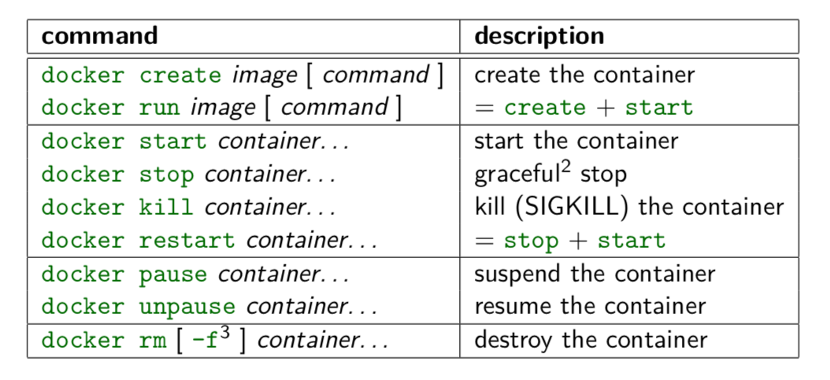
Container Management CLIs

Slide 29
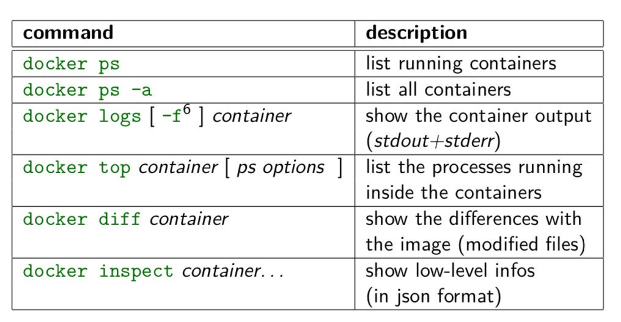
Inspecting The Container

Slide 30
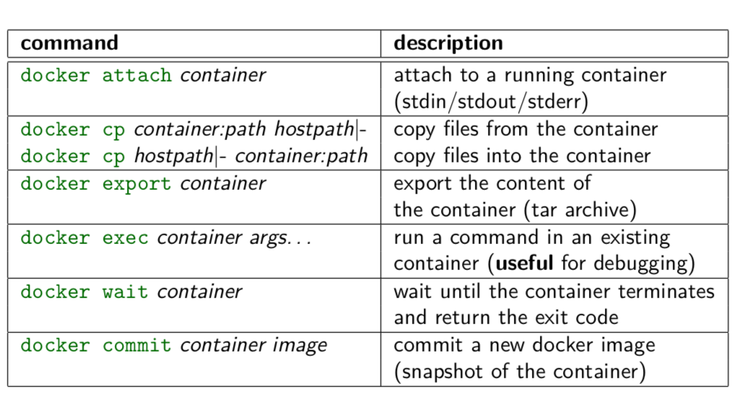
Interacting with Container

Slide 31
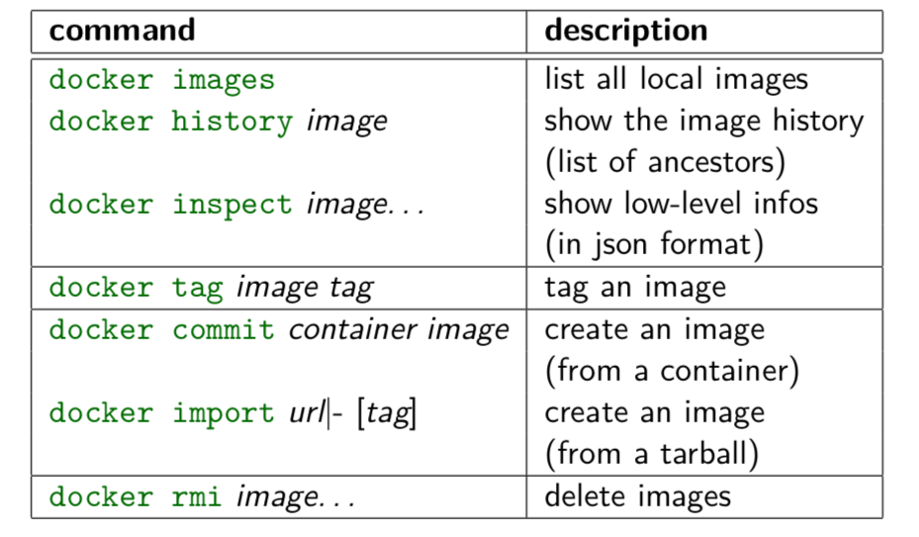
Image Management Commands

Slide 32
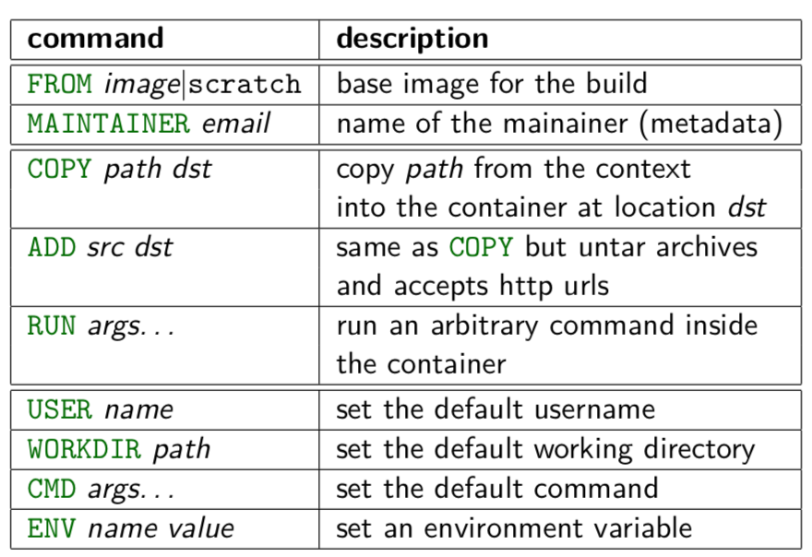
Builder Main Commands

Slide 33
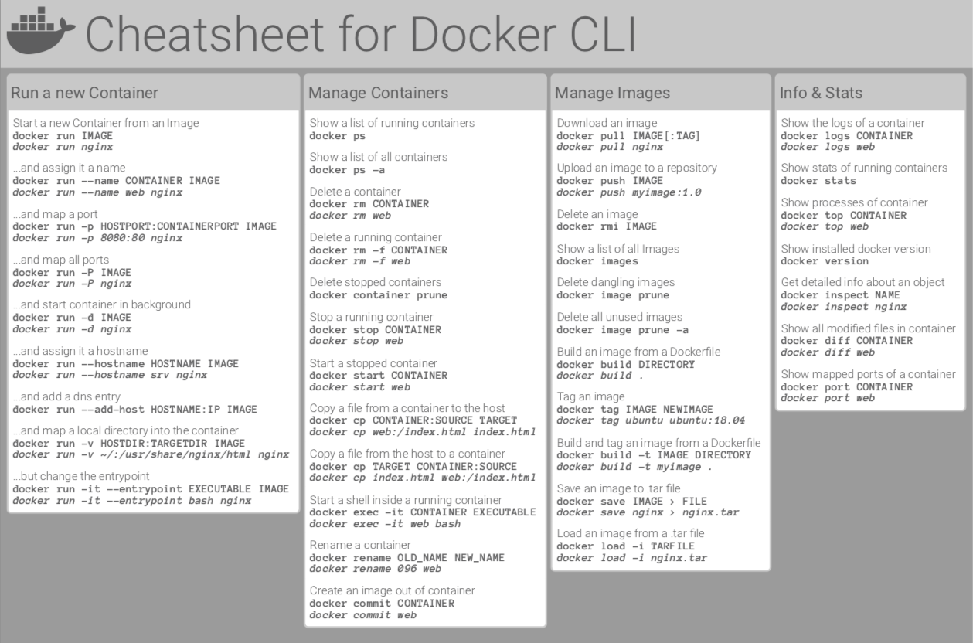

Slide 34
BREAK

Slide 35
Dockerway
How to run build/commit command.
How to check the existing images.
How to check running containers of the docker machine.
Push/Pull to repository.
Spin container with the help of the docker.
How to check logs running container.
Port mapping from container to outside world
How to stop the container

Slide 36
Continue..
Docker build command ,Docker images
Docker tag
Docker run
Docker login
Docker pull,Docker push,Docker ps or Docker ps –a Docker kill –rf
Docker commit command would save the changes we made to the Docker container’s file system to a new image.
docker commit container_ID repository_name:tag

Slide 37
Container Orchestration Engine
Container orchestration engine automates deploying, scaling, managing containerized application on a group of the servers.
It is known as COE.

Slide 38
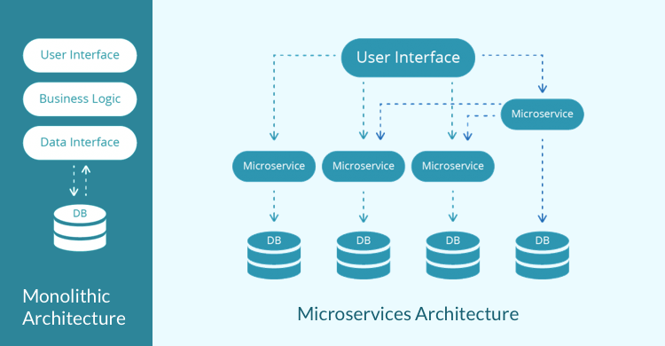
Microservices

Slide 39
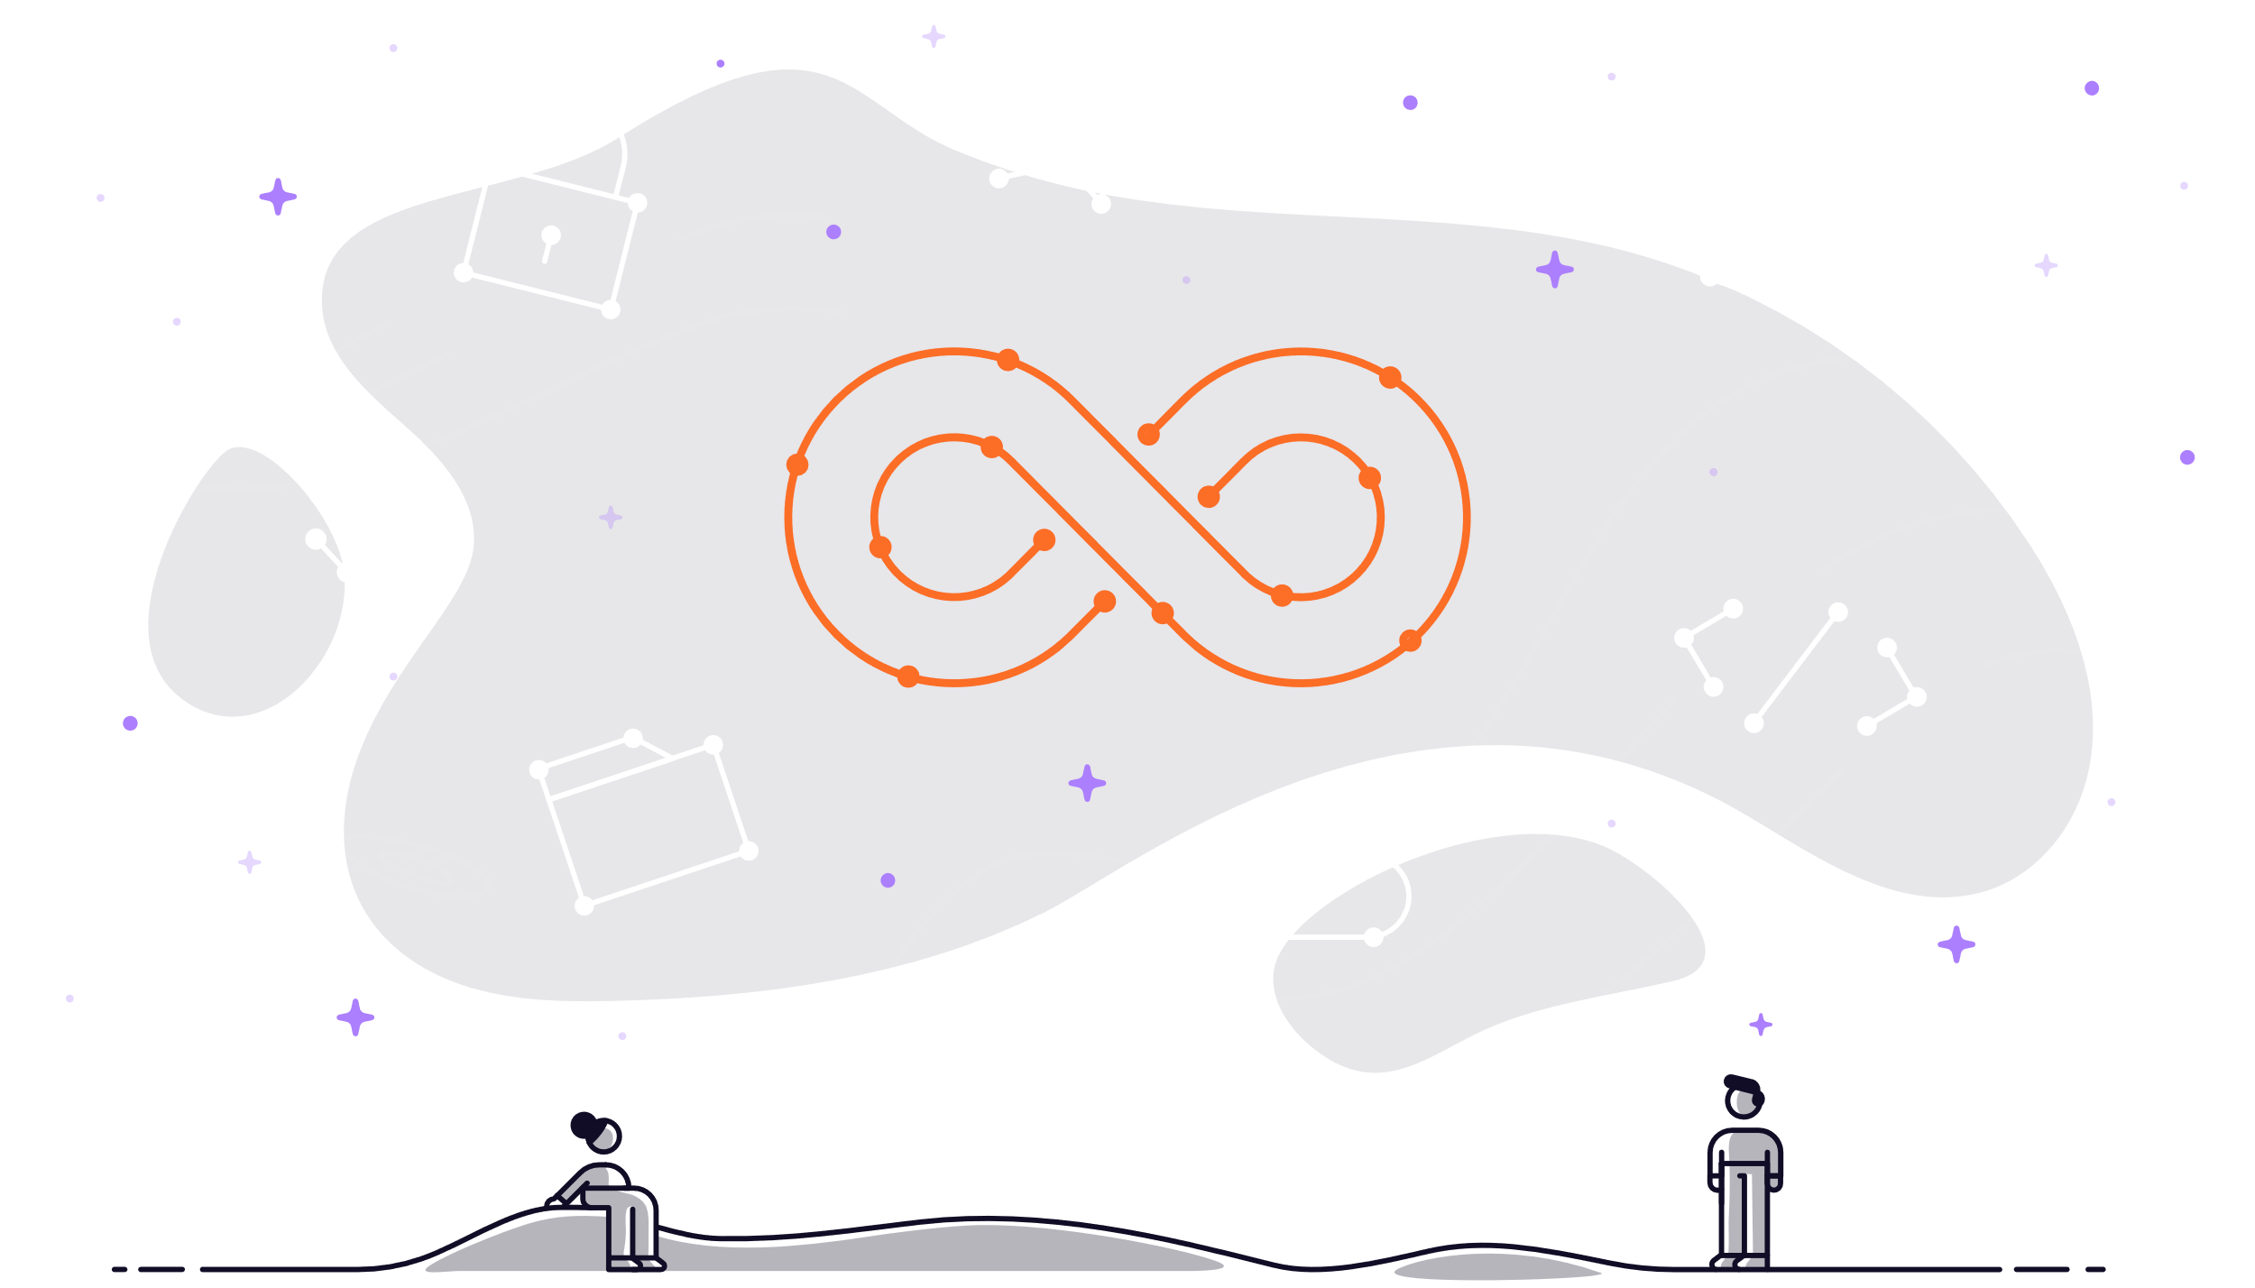
Microservices Problem

Slide 40
COE Enables
Clustering
Scheduling
Scalability
LB
Fault tolerance
Deployment

Slide 41
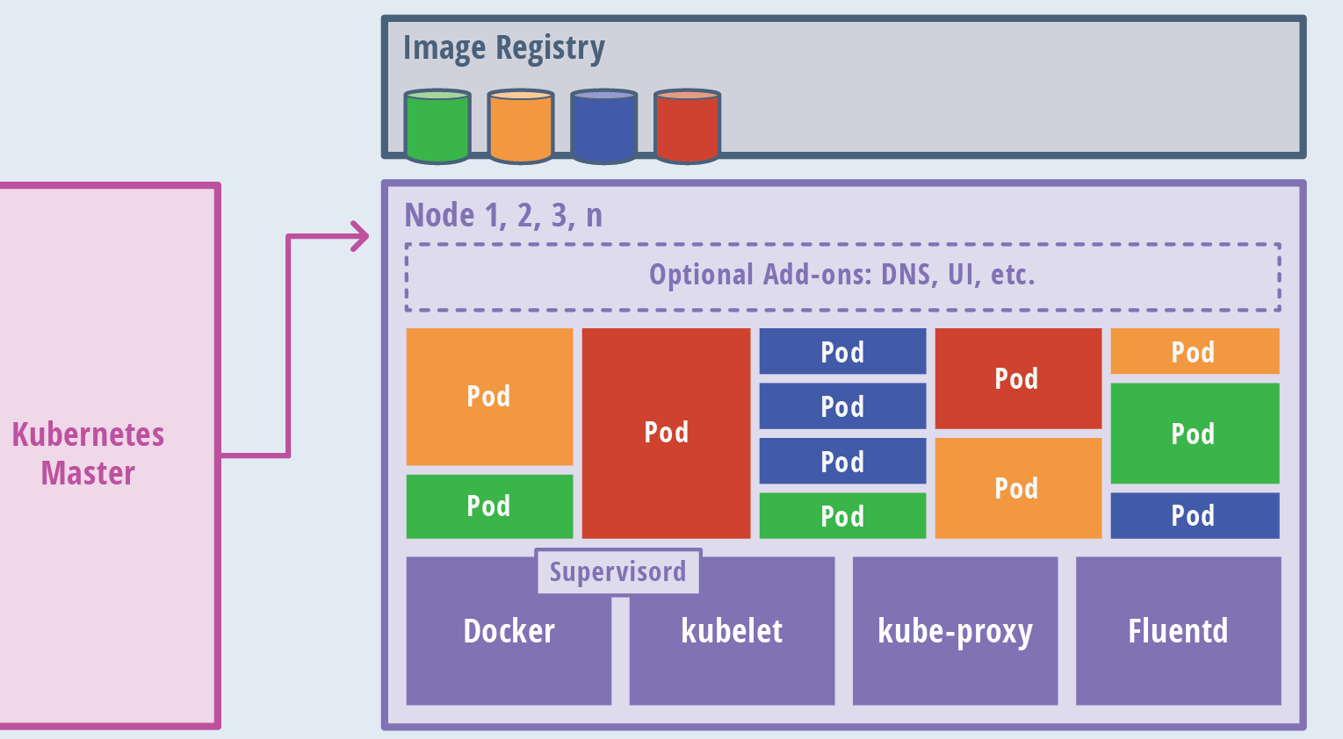
COE Not Always Required ?

Slide 42
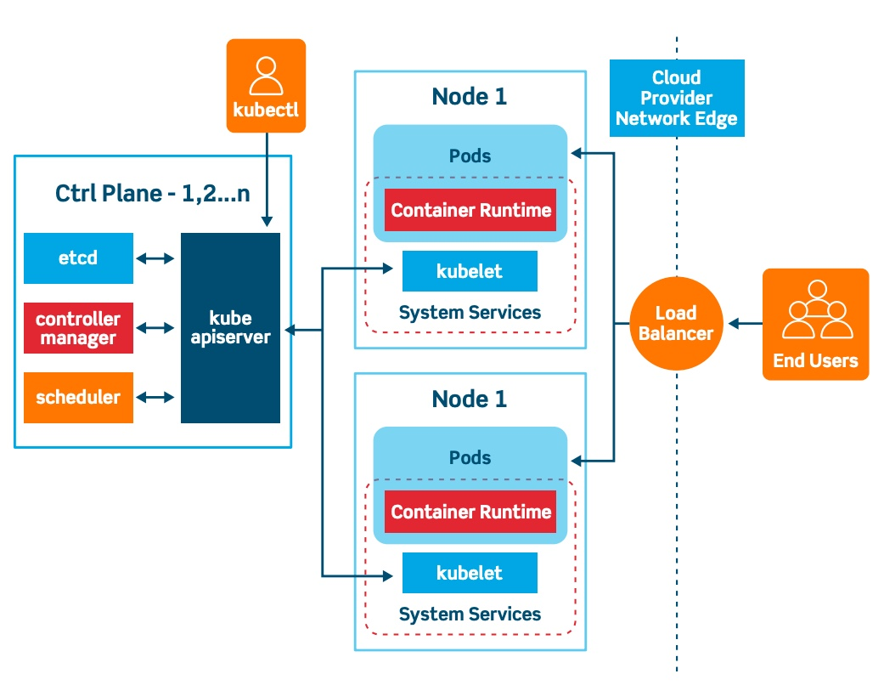
Kubernetes Arch

Slide 43
Basic of Kubernetes
Kubernetes also known as K8s was built by Google based on their experience running containers in production. It is now an open-source project and is arguably one of the best and most popular container orchestration technologies out there. We are using the same to achieve Orchestration. It simply provide automated arrangement, coordination, and management of complex computer systems, and services.
The main components are (details of the it will cover in training)
Nodes
Cluster
Master

Slide 44
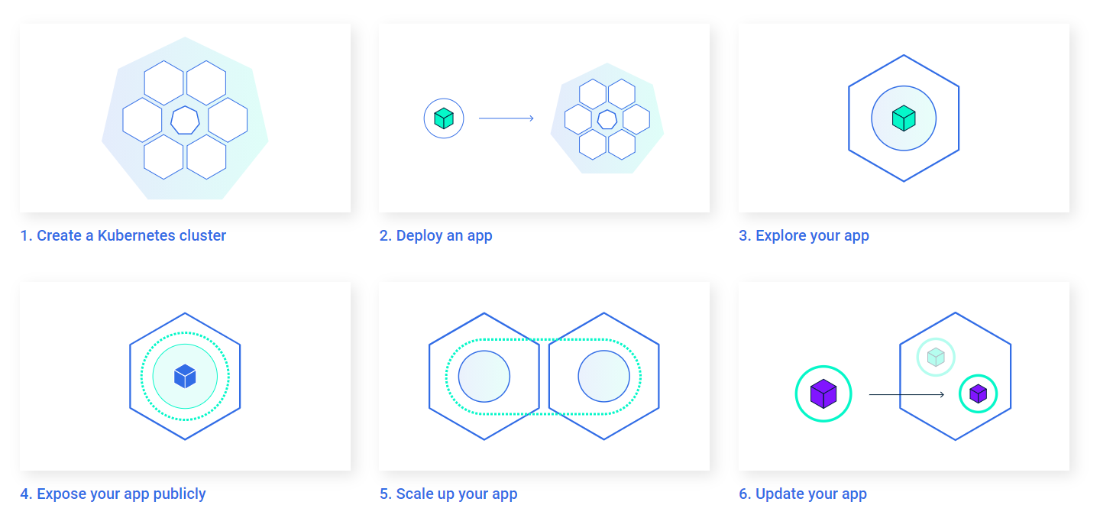

Slide 45
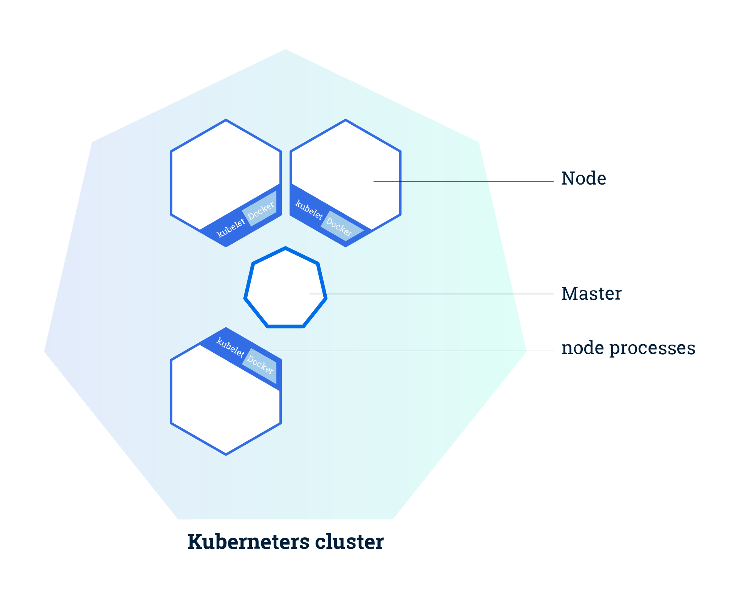

Slide 46
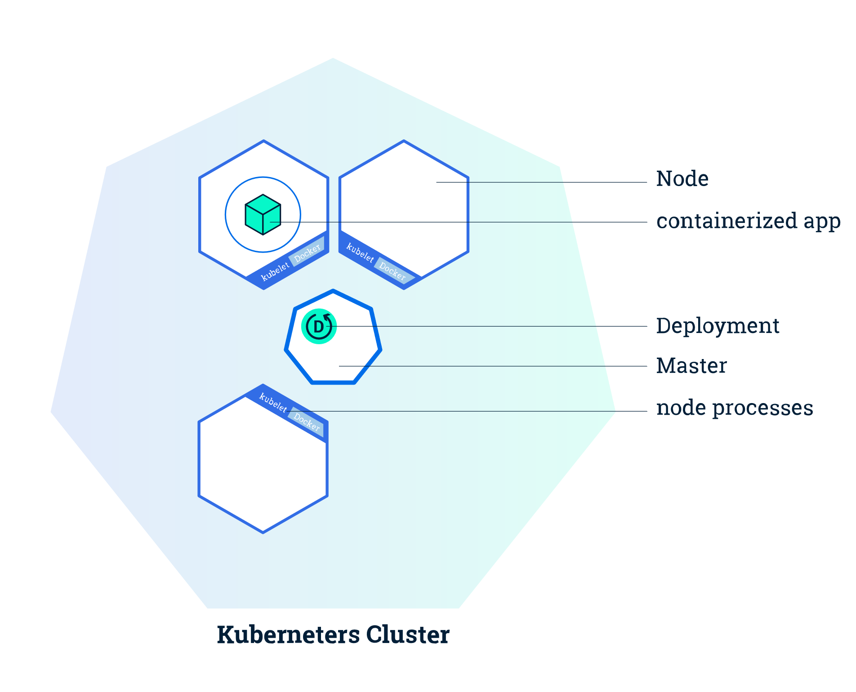

Slide 47
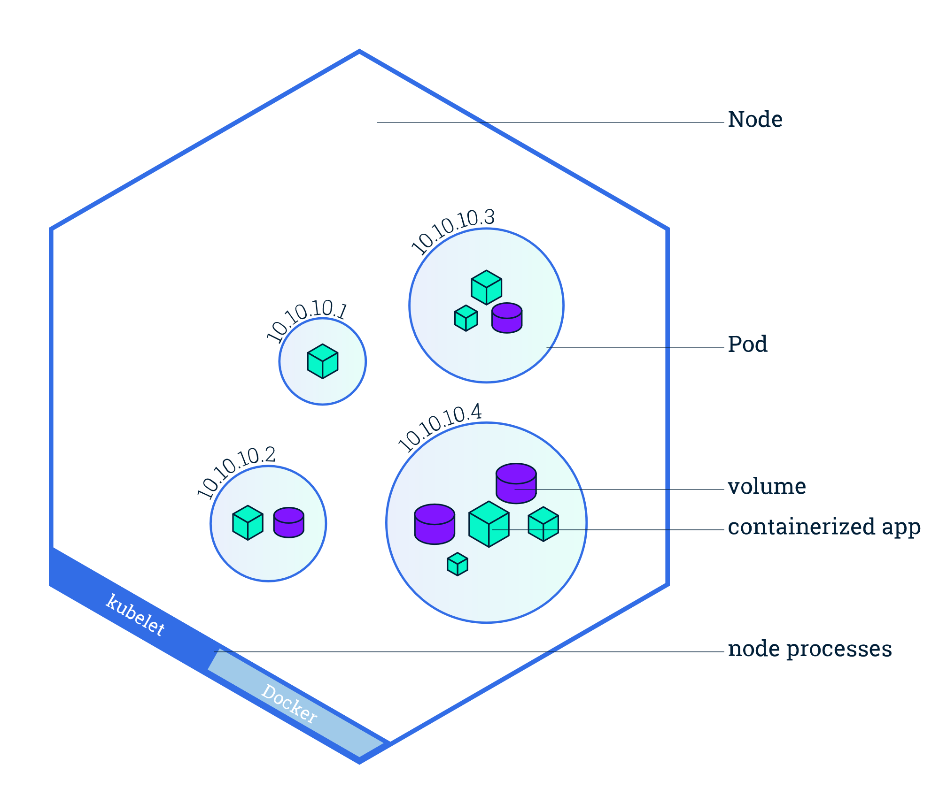

Slide 48
Pre-requisite:
Creating Your Docker/Github Hub Account
https://labs.play-with-k8s.com/

Slide 49
Kubernetes Basic commands
Get cluster information
kubectl cluster-info
Get all nodes
kubectl get nodes
Get all namespaces
kubectl get namespace
Create namespace
kubectl create namespace <name>
Delete namespace
kubectl delete namespace <name>

Slide 50
Continue..
Get all objects for particular namespace kubectl get all –n <name>
Execute yaml File
kubectl apply –f <yaml file> kubectl create –f <yaml file>
Delete service
kubectl delete service <service name> - n <name>
Delete deployment
kubectl delete deployment <deployment name> -n <name>
Describe deployment
kubectl describe deployment <deployment name>
Describe pod
kubectl describe pod <pod name>

Slide 51
Deployment
If an image is a class, then a container is an instance of a class - a runtime object. Containers are lightweight and portable encapsulations of an environment in which to run applications. Containers are created from images. Inside a container, it has all the binaries and dependencies needed to run the application.
We need to write YAML file to create for the deployment with the image we created with the help of docker.
Deployment internally have multiple things like Replica set/Pod definition/Volume mounts etc.
With the help of the deployment on the basis of the configuration containers are available to provide there services.

Slide 52
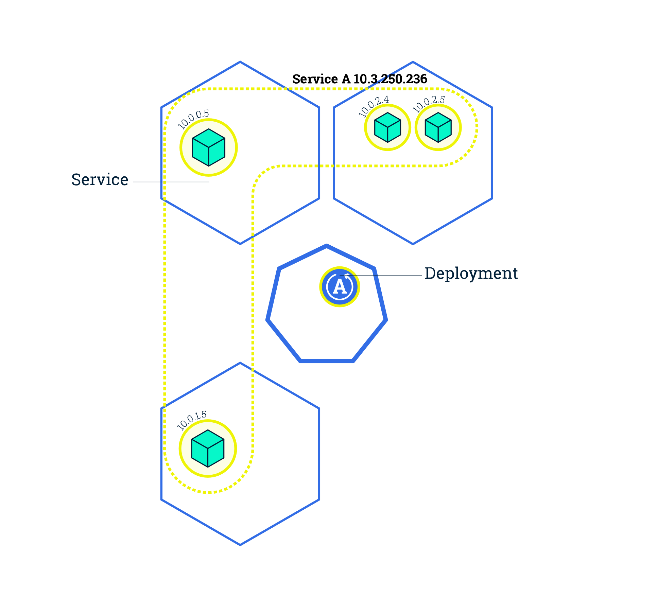
Deployment

Slide 53
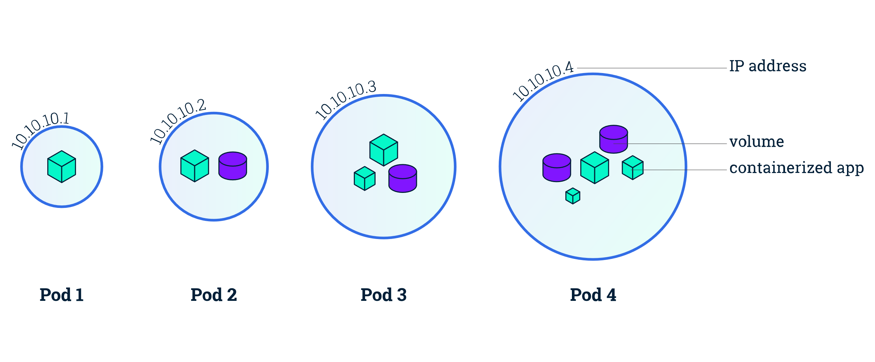

Slide 54
Service
Service is the feature of the kubernetes with the help of which we will map the port of the container to the outer world.
In our lab we are using NodePort with the help of same our application are available on both nodes IP with the same port.

Slide 55
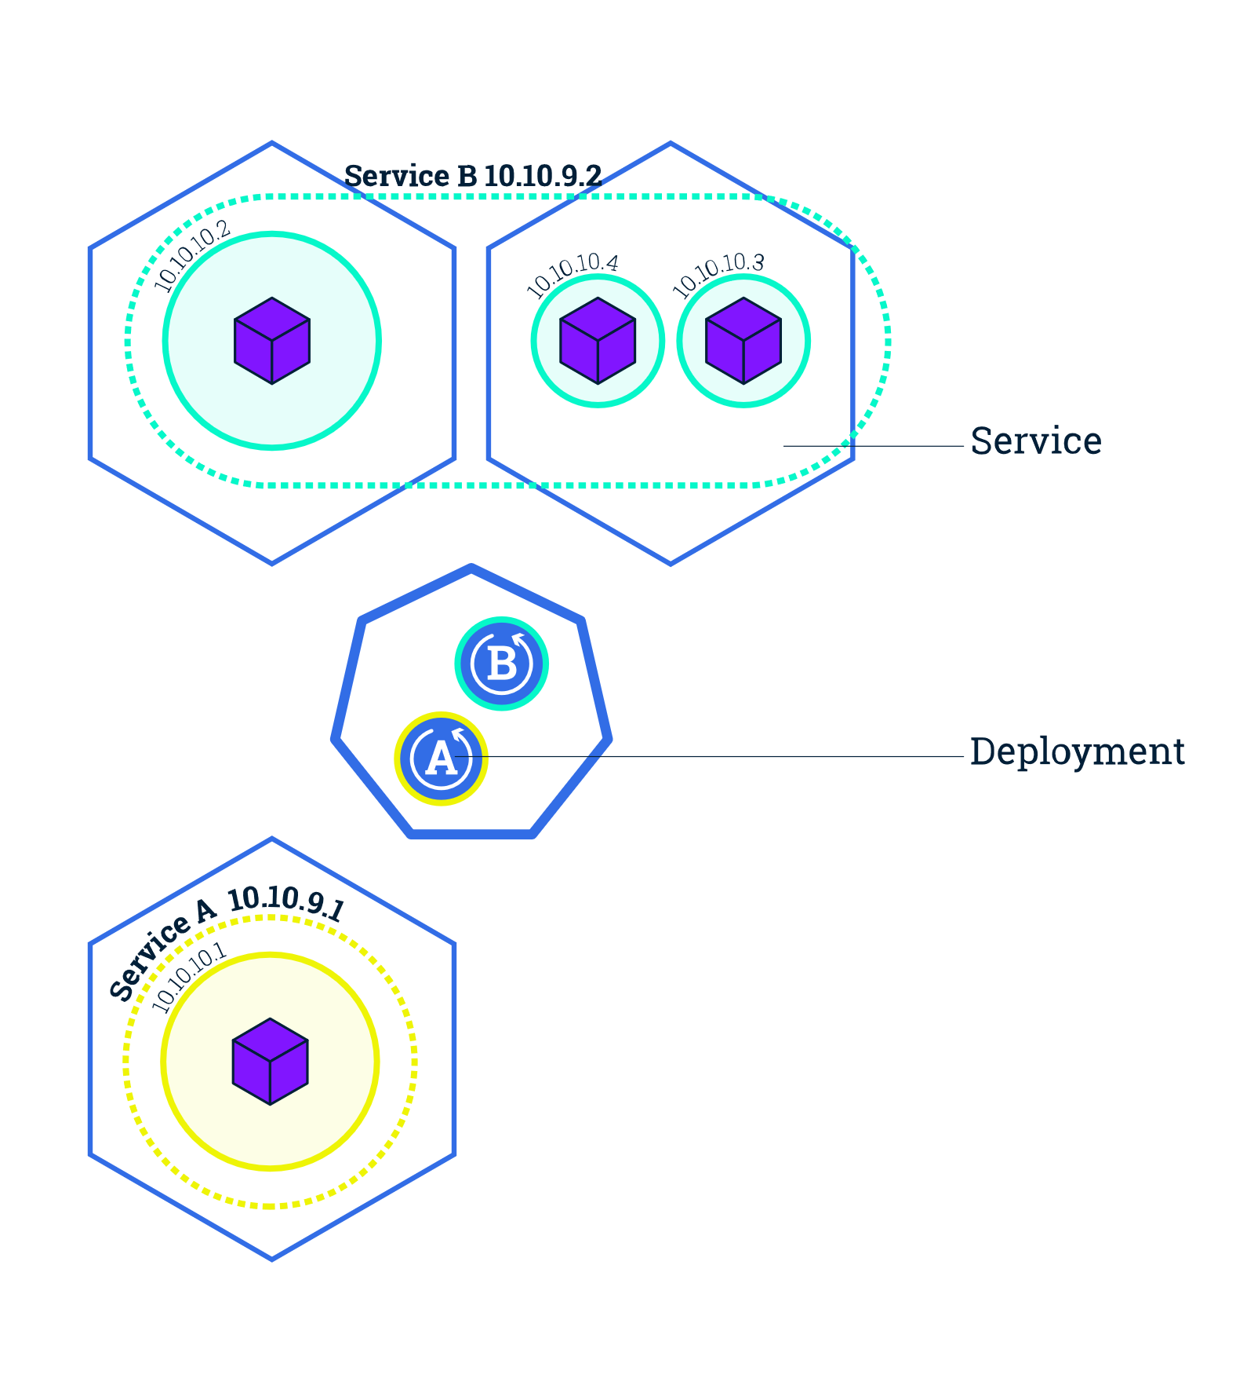
Service

Slide 56
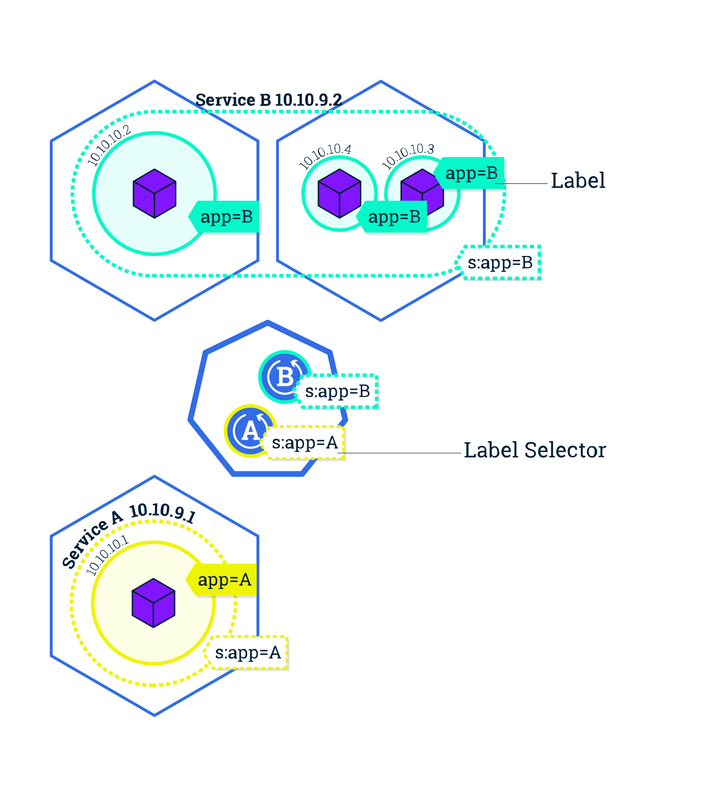

Slide 57
Pod Lifecycle

Slide 58
Container Creation & Deployment
Show case end to end start from image creation to deployment of the image though kubernetes.
Demo.

Slide 59
Application Checkup
There are three machine involved in the containerization.
1. Master : <ip>
2. Worker: <ip>
Application deployment are carrying out by kubernetes so all the command started by the kubectl are always running from the master node only.
Application deployed on any of the worker nodes .9 or .12 as per the resource availability.
Commands to check the application is running
kubectl get all –n dsdp [output of this include all the 21 capability] kubectl get all –n dsdp|grep “afl” [for AFL relevant details]
With the help of status we will know things are working or not.

Slide 60
Application running on which machine
kubectl get all –n dsdp –o wide
With the above command we get to know on which server our application is working because for the high availability once we create service our application is accessible from all the nodes on the same port.

Slide 61
Config changes reflection
We need to change config files at the path for each capability on master node only. .18 machine.
We are using configmaps for the same. So we need to delete the existing map and create the new map for example.
kubectl delete configmap config-nm -n dsdp
kubectl create configmap config-nm --from-file=/home/dsdp/NM/config/ -n dsdp

Slide 62
Start deployment
We need to go in the capability folder on the .18 server kubectl create –f dsdp-{capability Short name}-deployment.yaml

Slide 63
Stop deployment
We need to run the below command on master node.
kubectl get all –n dsdp|grep nm
kubectl delete deployment nm-deployment –n dsdp

Slide 64
Performing a rolling update for an app

Slide 65
Performing a rolling update for an app

Slide 66
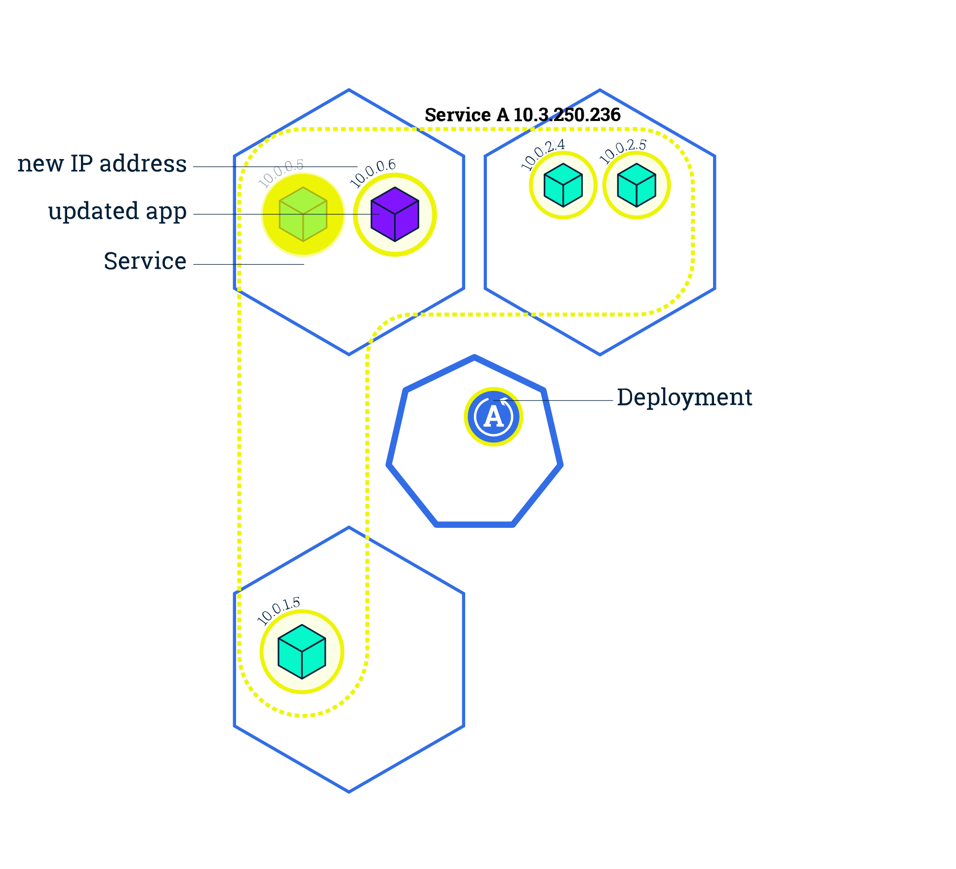
Performing a rolling update for an app

Slide 67
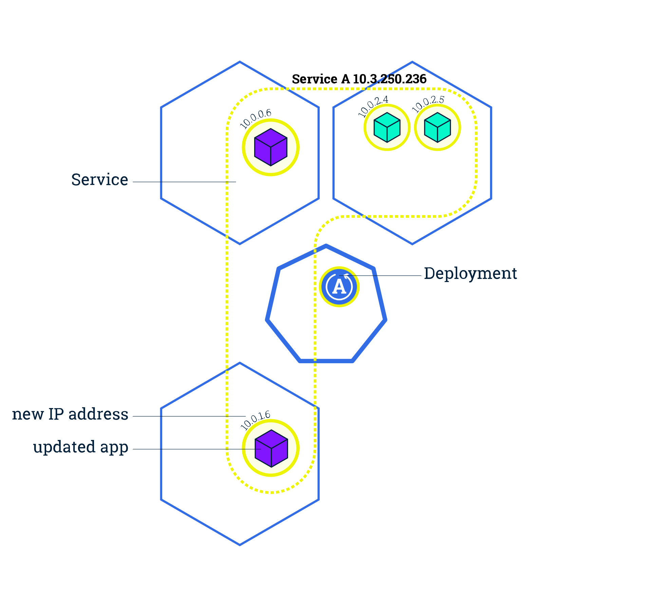
Performing a rolling update for an app

Slide 68
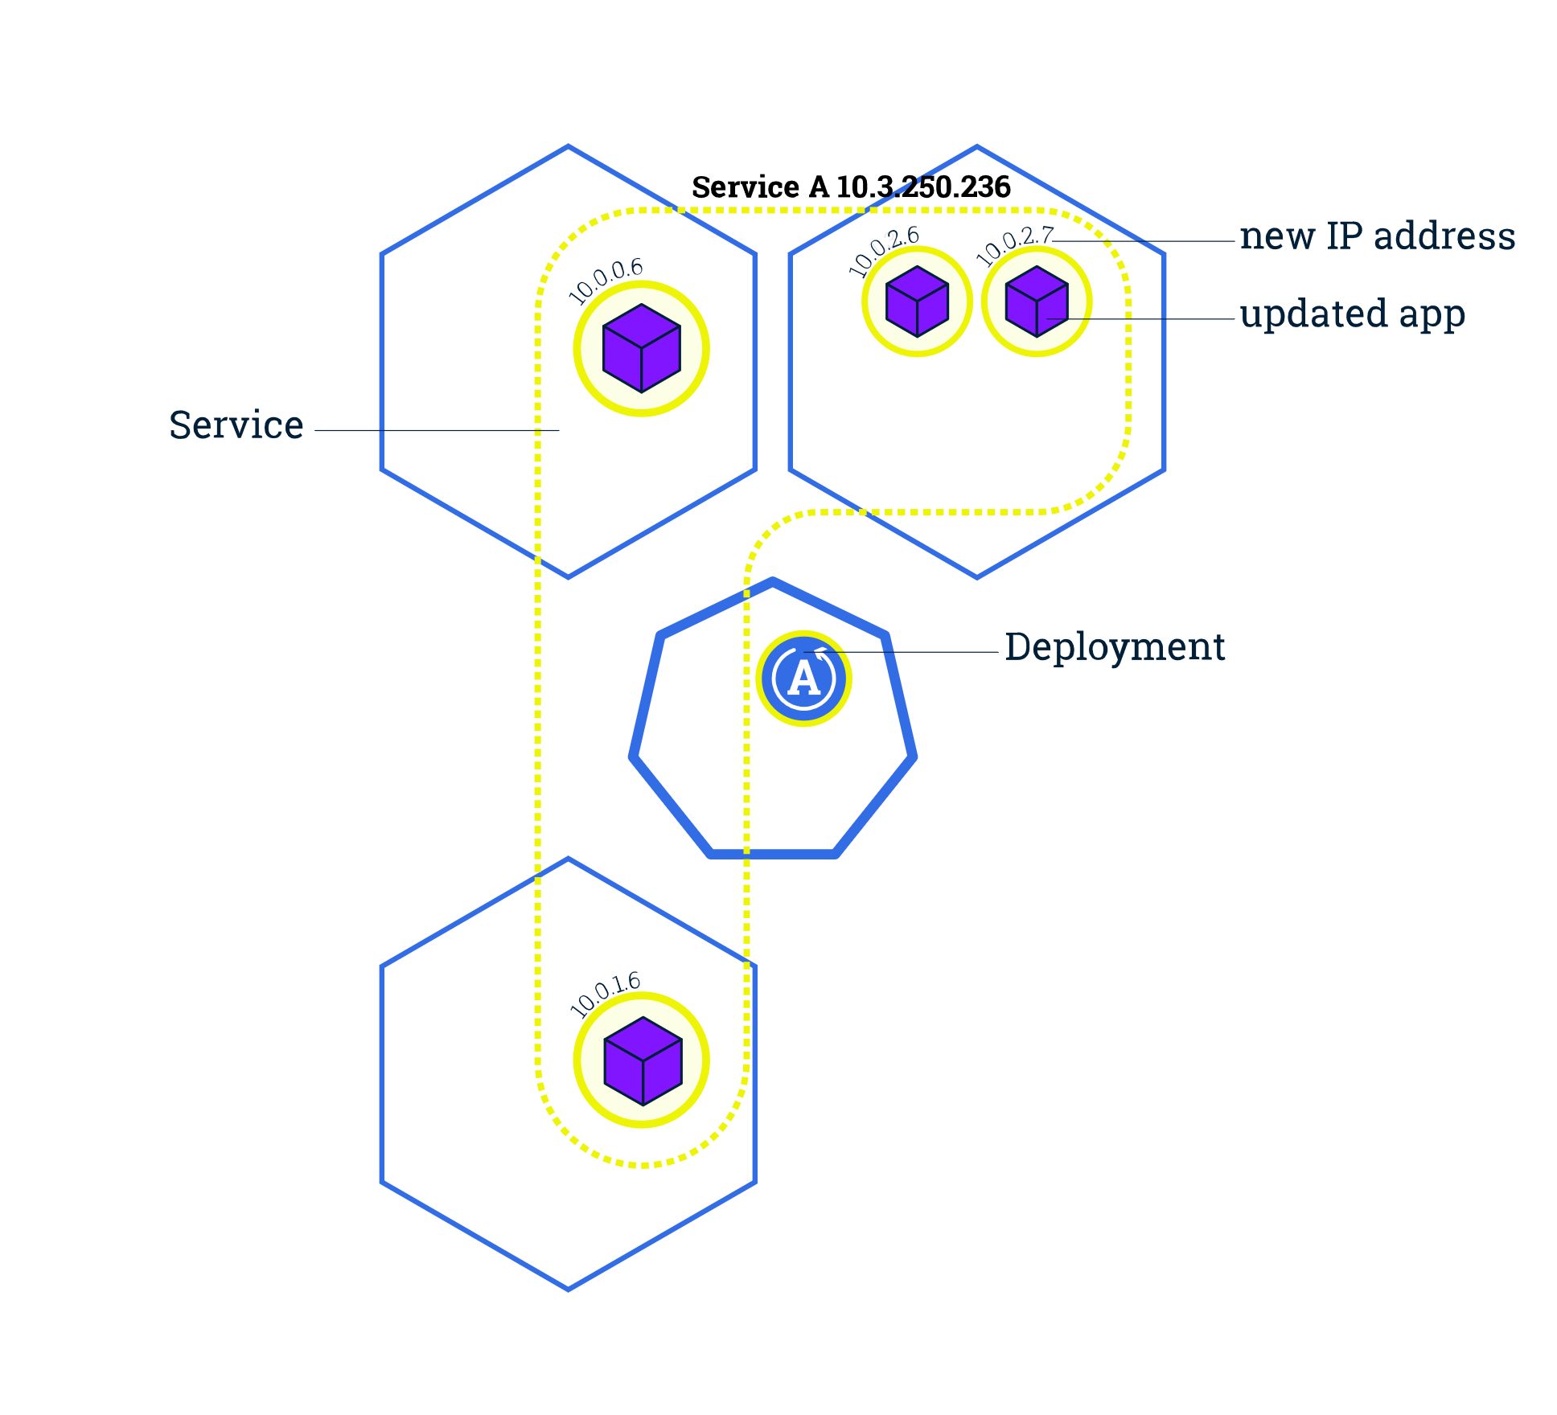

Performing a rolling update for an app

Slide 69
THANK YOU
www.comviva.com
CONFIDENTIAL AND PROPRIETARY
All trade marks, trade names, symbols, images, and contents etc. used in this document are the proprietary information of Comviva Technologies Limited. Unauthorized copying and distribution is prohibited.
© 2019 Comviva Technologies Limited. All rights reserved

